Slide 1
ECE 3364 Circuits and Systems
Lecture Set #2
Balanced Three-Phase Circuits
Version 10
Dr. Dave Shattuck
Associate Professor, ECE Dept.
Shattuck@uh.edu
(713) 743-4422

Slide 2
Overview of this Lecture Set Balanced Three-Phase Circuits
In this set of lecture notes, we will cover an important area in the transmission of power. We will review the following topics:
Balanced Three-Phase Voltages
Wye-Wye Circuits
Wye-Delta Circuits
Power Calculations in Balanced Three-Phase Circuits

Slide 3
Textbook Coverage
This material is introduced in different ways in different textbooks. Approximately this same material is covered in your textbook in the following sections:
Electric Circuits 12th Edition by Nilsson and Riedel: Sections 11.1 through 11.5

Slide 4
Copyright Notice
This work is protected by United States copyright laws and is provided solely for the use of instructors in teaching their courses and assessing student learning. Dissemination or sale of any part of this work (including on the World Wide Web) will destroy the integrity of the work and is not permitted. The work and materials from it should never be made available to students except by instructors using the accompanying text in their classes. All recipients of this work are expected to abide by these restrictions and to honor the intended pedagogical purposes and the needs of other instructors who rely on these materials.

Slide 5
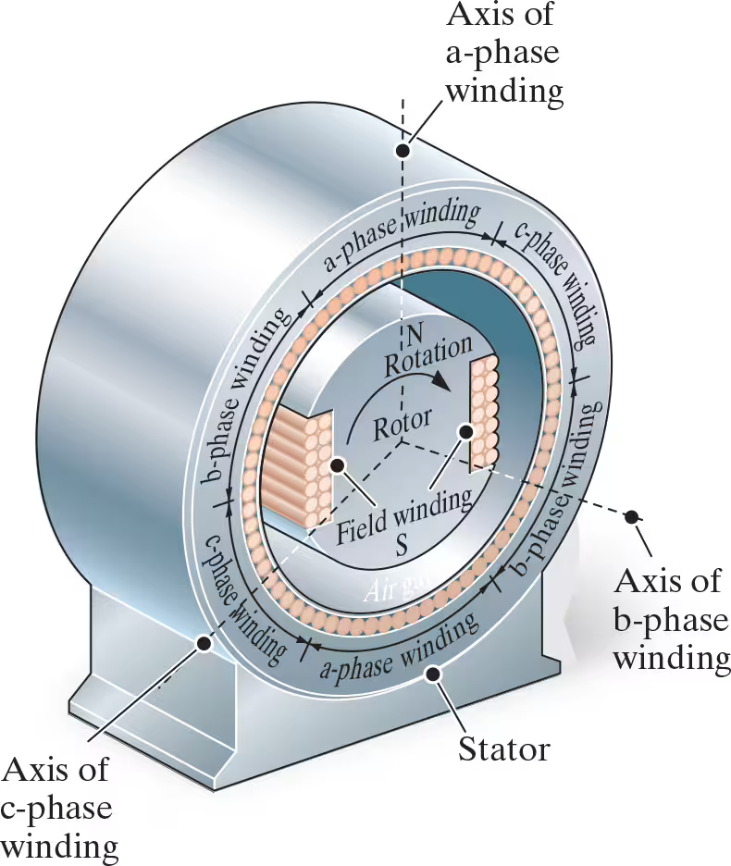
Three-Phase Power Distribution
It is common to use three-phase circuits to generate, transmit, and distribute electrical power. We are going to look at what are called “balanced three-phase circuits”, which is a special case of interest because it simplifies many of the calculations.
This image taken from Figure 11.3 in Nilsson and Reidel, Electric Circuits, 12th Edition.
Notes:
The generator consists of a rotor surrounded by a circular stator with an air gap between them. The rotor in the middle has a clockwise rotating electromagnet, padded with field winding S on two sides. The rotor undergoes N rotation in the clockwise direction. The surrounding stator consists of two sets of three separate windings distributed on its periphery, with these sets labeled “a”-phase winding, b-phase winding, and c-phase winding. Three dashed lines are drawn from the center of the rotor to the periphery of the stator, separated by an angle of 120 degrees. These lines represent axes of the “a”-phase winding, b-phase winding, and c-phase winding.

Slide 6
Why Three-Phase Circuits?
It is a reasonable question to ask why do we use three-phase circuits?
I had the same question. I found a pretty good web site that gives a pretty clear description of the answer. It is https://www.youtube.com/watch?v=c9gm_NL7KyE
If you watch this video, you will find an explanation in graphical form, showing that the power available from three-phase circuits “more constant”, that is, has smaller changes in time than a single phase, or a single sinusoid.

Slide 7
RMS Voltages and Currents
It is a reasonable question to ask why do we use three-phase circuits?
I had the same question. I found a pretty good web site that gives a pretty clear description of the answer. It is https://www.youtube.com/watch?v=c9gm_NL7KyE
This same video also describes why we use rms voltages and currents, although their wish to avoid doing mathematical calculations leads to a different approach to explaining where the conversion from the periodic waveform to the rms value comes from.

Slide 8
Derivation of RMS – 1
We want the effective value that could be used in power calculations, for average power, in the formula
We will do the derivation for a resistance, since we want the formula to work with the resistance power formulas. Let’s arbitrarily choose to work with the voltage. What we want to get is a value that will work in the formula,
With T as the period, the average value of the power is obtained by the formula,

Slide 9
Derivation of RMS – 2
Now, to get the formula, we simply set the two equations from the previous slide equal to each other,
Now, we need to simplify. The resistance is assumed to be a constant, and so it can be taken out of the integral. When we multiply both sides by R, we get

Slide 10
Derivation of RMS – 3
Finally, we can solve for the rms value of the voltage, by taking the square root of both sides,
This is the result that we have been working toward. We only need to interpret this result. We have taken the periodic voltage, v(t), and squared it. Then, by integrating it over a period and dividing by the period, we are taking the mean value of the squared function. Finally, we take the square root of the mean value of the squared function. We call this rms.

Slide 11
RMS Value of a Sinusoid
The rms value for a general periodic function, x(t), is
Now, this was derived for any periodic function. The function must be periodic for the formula for the mean value to apply.
If we perform the calculus to get the rms value for a sinusoid, we find the rms value is equal to the zero-to-peak value (or amplitude) divided by the square root of 2, or
Remember, this only holds for sinusoids!

Slide 12
Power with Sinusoids – 1
If we have sinusoidal voltages and currents, we can get the power by multiplying the two. We could plot the power as shown below. These curves were obtained by taking a couple of arbitrary sinusoids for voltage and current. If you change the magnitudes and phases, these curves will change.

Slide 13

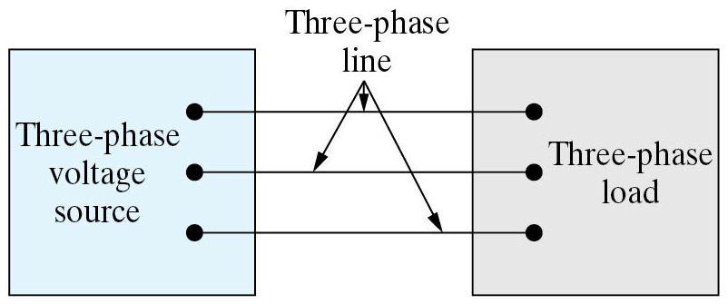
Three-Phase Power Distribution
We return to this diagram taken from the textbook at right, to talk about how we get the three-phase voltage sources that we will be using moving forward. This generator forms the “Three-phase voltage source” in the diagram below.
The diagram above is Figure 11.3 in the Nilsson and Reidel textbook, 12th Ed. The diagram at left is Figure 11.1 from that textbook.
Notes:
The two boxes contain three terminals each, which are connected by three parallel wires. The box on the left is labeled three-phase voltage source and the box on the right is labeled three-phase load. The connecting lines are labeled three-phase line.

Slide 14
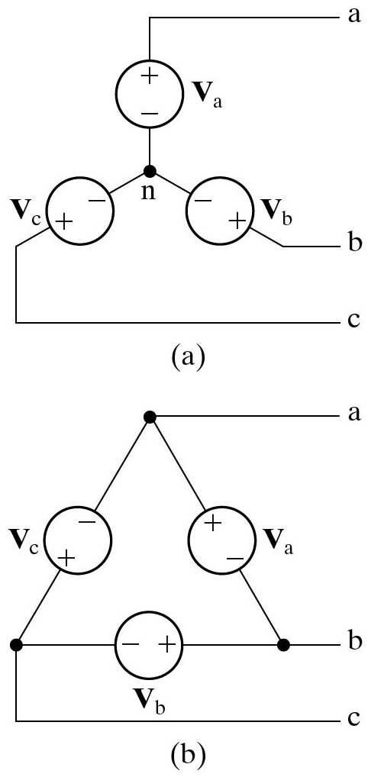
Three-Phase Power Distribution
This generator can be modeled as the three voltage sources in the diagram below.
The diagram above is Figure 11.3 in the Nilsson and Reidel textbook, 12th Ed. The diagram at left is Figure 11.4(a) from that textbook.
Notes:
Part ("a"), Y-connected: The elements present in the circuit are three voltage sources labeled V subscript "a", V subscript b, and V subscript c. The negative terminals of V subscript "a", V subscript b, and V subscript c are connected at a node labeled n. The positive terminal of V subscript "a" is connected to terminal "a". The positive terminal of V subscript b is connected to terminal b. The positive terminal of V subscript c is connected to terminal c. This diagram is given in the phasor domain.

Slide 15
Three-Phase Power Distribution
This generator can also be modeled as the three voltage sources in delta-connected diagram below.
The diagram above is Figure 11.3 in the Nilsson and Reidel textbook, 12th Ed. The diagram at left is Figure 11.4(b) from that textbook.
Notes:
Part (b), Delta-connected: The elements present in the circuit are three voltage sources labeled V subscript "a", V subscript b, and V subscript c. The positive terminal of V subscript "a" and the negative terminal of V subscript c are connected to terminal "a". The negative terminal of V subscript "a" and the positive terminal of V subscript b are connected to terminal b. The negative terminal of V subscript b and the positive terminal of V subscript c are connected to terminal c.
This diagram is given in the phasor domain.

Slide 16
Two Models for the Generator
Let us compare the Y-connected source in (a) and the Δ-connected source in (b). We should note that V_{a} in the two diagrams are not the same voltage.
The diagrams are Figure 11.4 in the Nilsson and Reidel textbook, 12th Ed.
Notes:
These diagrams are given in the phasor domain. Note that V_{a} in (b) is equal to V_{a} – V_{b} in (a).

Slide 17
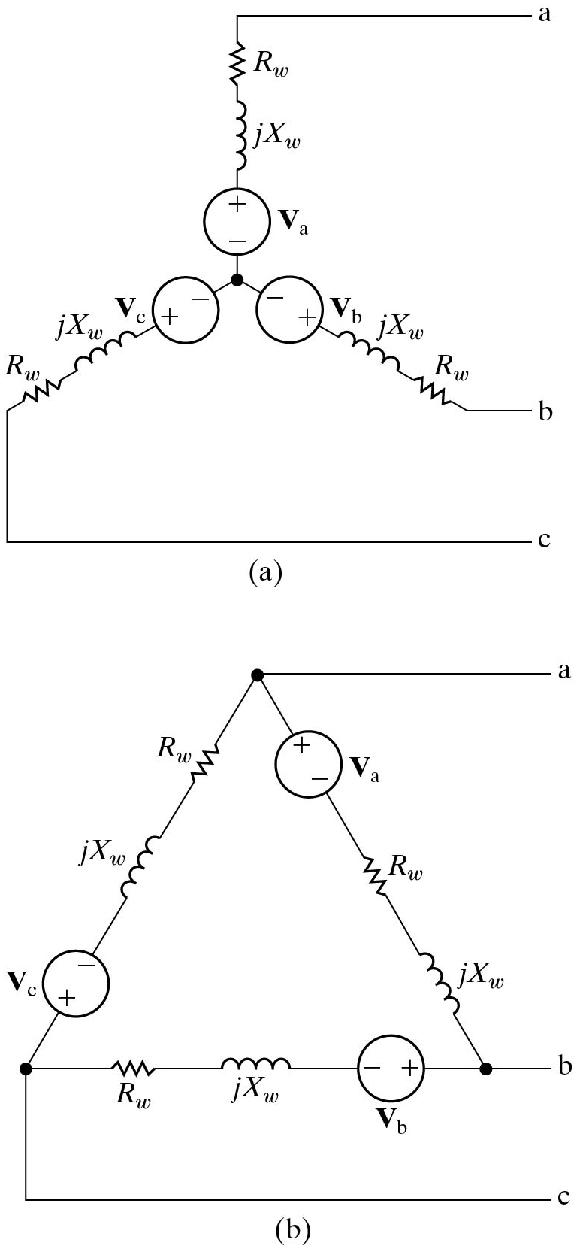
Two More Complicated Models for the Generator
These diagrams include the winding impedances, assuming a balanced circuit.
The diagrams are Figure 11.5 in the Nilsson and Reidel textbook, 12th Ed.
Notes:
These diagrams are given in the phasor domain. Note that V_{a} in (b) is equal to V_{a} – V_{b} in (a).

Slide 18
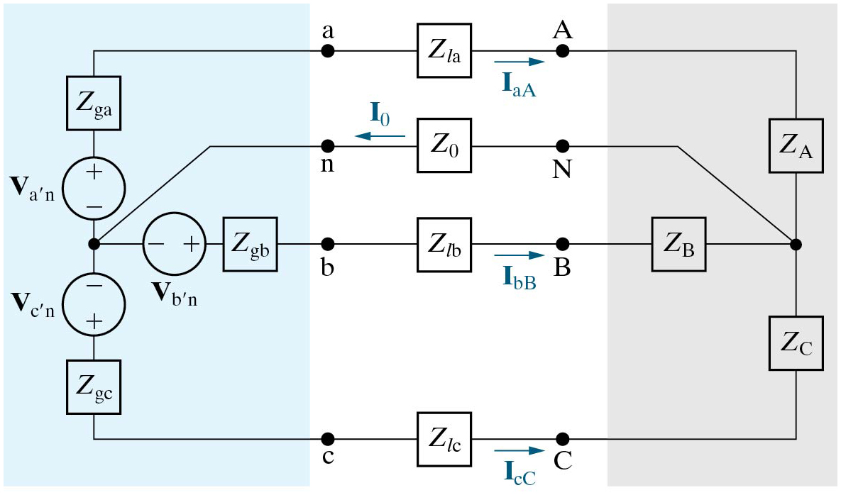
A Three Phase Y-Y System
We will use this diagram to consider the Three-Phase circuit, with source and load both in the Y-configuration.
The diagram is Figure 11.6 in the Nilsson and Reidel textbook, 12th Ed.
Notes:
This is the general case. We will introduce what we mean by a “Balanced Three-Phase Circuit” next.

Slide 19
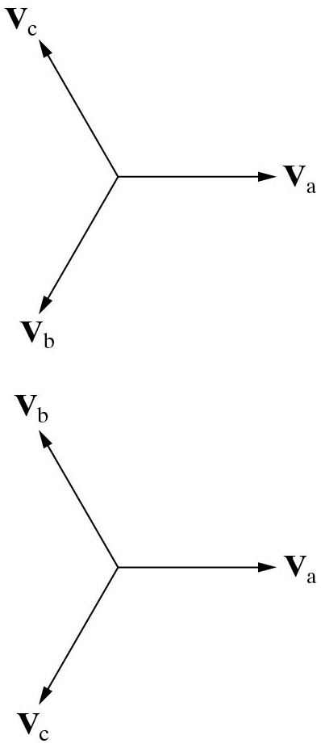

Balanced Three-Phase Voltages
A set of Balanced Three-Phase Voltages consists of three sinusoidal voltages that have identical amplitudes and frequencies but are out of phase with each other by exactly 120°.
If we take the phasors of each of the voltages, then we can plot those phasors in the complex plane. This is done at left.
The diagram is Figure 11.2 in the Nilsson and Reidel textbook, 12th Ed.

Slide 20
Balanced Three-Phase Voltages
A set of Balanced Three-Phase Voltages consists of three sinusoidal voltages that have identical amplitudes and frequencies but are out of phase with each other by exactly 120°.
The top version is called the abc, or positive sequence. The bottom version is called the acb, or negative sequence.
The diagram is Figure 11.2 in the Nilsson and Reidel textbook, 12th Ed.

Slide 21
Balanced Three-Phase Voltages
A set of Balanced Three-Phase Voltages consists of three sinusoidal voltages that have identical amplitudes and frequencies but are out of phase with each other by exactly 120°.
If we add these three phasors, we should be able to see that by vector addition, we have
The diagram is Figure 11.2 in the Nilsson and Reidel textbook, 12th Ed.

Slide 22
Balanced Three-Phase Circuits
A Balanced Three-Phase Circuit meets four conditions:
The voltage sources form a balanced three-phase set. Their magnitudes are equal, and they are 120° apart in phase.
The impedance of each phase of the voltage source is the same.
The impedance of each line is the same.
The impedance of each phase of the load is the same.

Slide 23
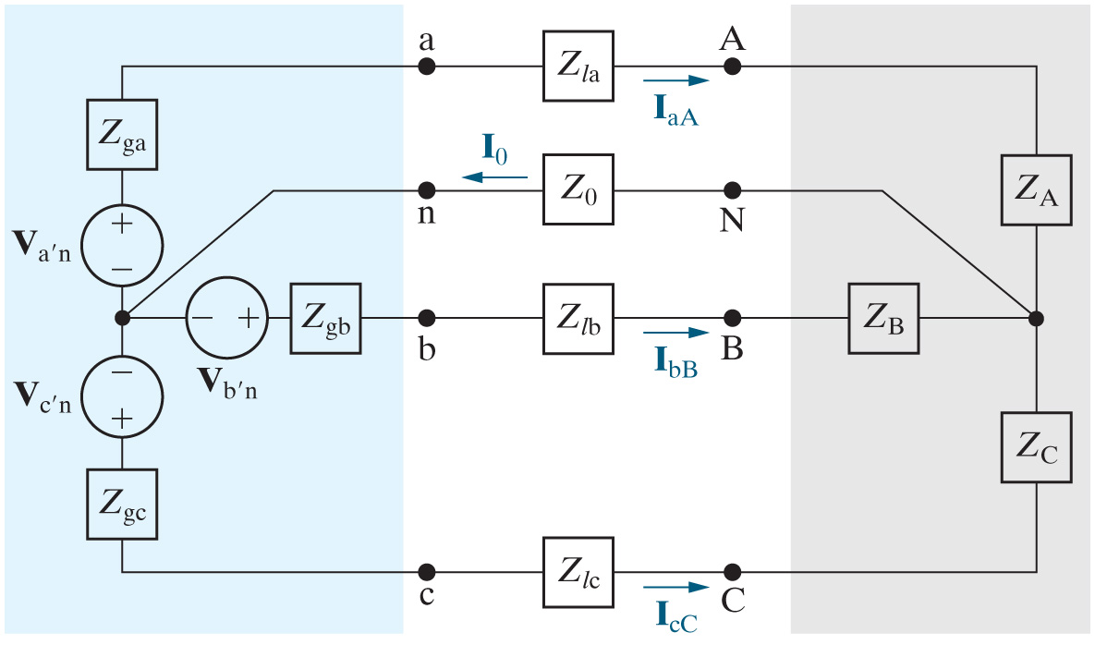
Balanced Three-Phase Circuits
Balanced three-phase circuits:
Equal impedances (source, line and load) in all phases
Sources have equal magnitudes, are 120° out of phase, so they form a balanced set.
If a balanced circuit, no current in the neutral line

Slide 24
Balanced Three-Phase Y-Y Circuit
The diagram is Figure 11.6 in the Nilsson and Reidel textbook, 12th Ed.
This analysis below is how we got the last bullet in the previous slide.
We can do KCL , with node n as the reference. We get

Slide 25
Other Useful Terminology
The diagram is Figure 11.6 in the Nilsson and Reidel textbook, 12th Ed.
There are other terms that are used in the context of three-phase power.
Line Voltage is the voltage across any pair of lines, typically at the load. For this case, the three line voltages are V_{AB}, V_{BC}, and V_{CA}.

Slide 26
Other Useful Terminology
The diagram is Figure 11.6 in the Nilsson and Reidel textbook, 12th Ed.
There are other terms that are used in the context of three-phase power.
Phase Voltage is the voltage across a single phase of the load. For this case, the three phase voltages are V_{AN}, V_{BN}, and V_{CN}.

Slide 27
Other Useful Terminology
The diagram is Figure 11.6 in the Nilsson and Reidel textbook, 12th Ed.
There are other terms that are used in the context of three-phase power.
Line Current is the current through a single line between the source and the load. For this case, the three line currents are I_{aA}, I_{bB}, and I_{cC}.

Slide 28
Other Useful Terminology
The diagram is Figure 11.6 in the Nilsson and Reidel textbook, 12th Ed.
There are other terms that are used in the context of three-phase power.
Phase Current is the current through a single phase of the load. For this case, the three phase currents are I_{aA}, I_{bB}, and I_{cC}. The Line Currents and Phase Currents for a Y-connected load are equal.

Slide 29
Other Useful Terminology
I_{AN}
The diagram is Figure 11.6 in the Nilsson and Reidel textbook, 12th Ed. We have added the three phase currents.
I_{BN}
I_{CN}
There are other terms that are used in the context of three-phase power.
Phase Current is the current through a single phase of the load. For this case, the three phase currents are I_{AN}, I_{BN}, and I_{CN}. These Phase Currents are used but not defined in the text.

Slide 30
Other Useful Terminology
I_{AN}
The diagram is Figure 11.6 in the Nilsson and Reidel textbook, 12th Ed. We have added the three phase currents.
I_{BN}
I_{CN}
It is not difficult to show that the line voltages form a balanced three-phase set. In addition, the phase voltages also form a balanced three-phase set.

Slide 31
Other Useful Terminology
I_{AN}
The diagram is Figure 11.6 in the Nilsson and Reidel textbook, 12th Ed. We have added the three phase currents.
I_{BN}
I_{CN}
The line voltages form a balanced three-phase set, and the phase voltages form a balanced three-phase set. The line currents and the phase currents also each form balanced three-phase sets. Remember, this means that they have the same magnitudes, and the phases differ by 120°.

Slide 32
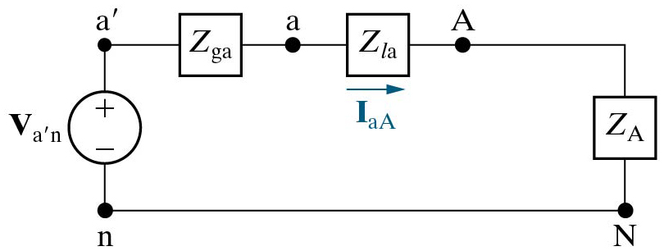
Single-Phase Equivalent Circuit
The diagrams are Figures 11.6 and 11.7 in the Nilsson and Reidel textbook, 12th Ed.
I_{AN}
We can draw what is called a single-phase equivalent circuit, as shown here. While useful for finding I_{aA}, it cannot be used to find I_{O}.
I_{BN}
I_{CN}
I_{AN}

Slide 33
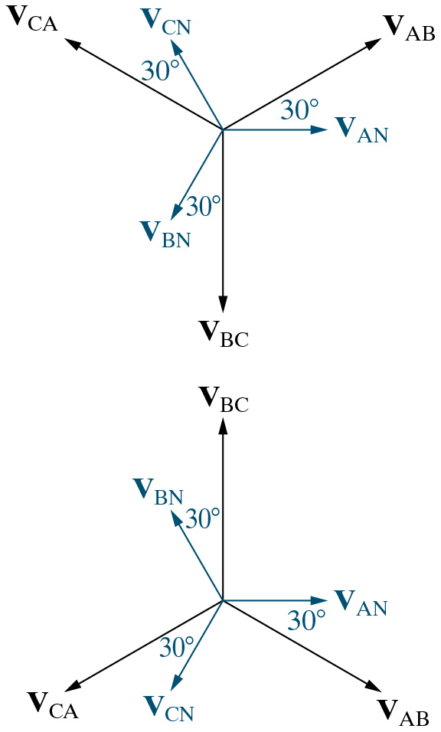
Line and Phase Voltages
For the Y-Y connection, we can use standard vector arithmetic to show that there is a relationship between the line voltages and the phase voltages, depending on the sequence.
Positive (abc) sequence:
Negative (acb) sequence:

Slide 34
Line and Phase Voltages
The notation below means the following: The magnitude of the line voltage is the square-root of three times the magnitude of the phase voltage.
Positive (abc) sequence:
Negative (acb) sequence:

Slide 35
Line and Phase Voltages
The notation below means the following: The phase of the line voltage is the 30 plus or minus that of the corresponding phase of the phase voltage.
Positive (abc) sequence:
Negative (acb) sequence:

Slide 36
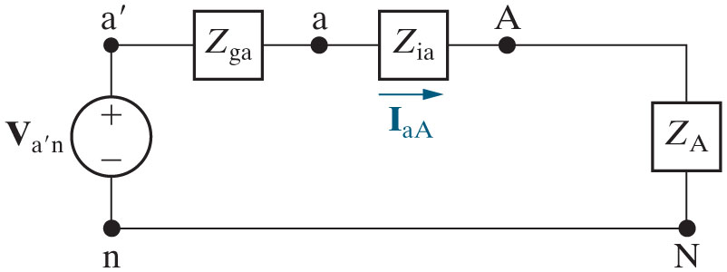
Y-Y Balanced Three Phase Circuits
So, we can do the following:
Analyze a balanced Y-Y
circuit using just the a-phase!
Analyze the a-phase circuit to calculate
line current
phase current
phase voltage
Calculate line voltage using
(a b c or a c b)
Calculate b-phase and c-phase voltages and currents by adding or
subtracting
from the phase angle of the a-phase values, depending
on whether the phase sequence is positive or negative

Slide 37
Does the Single-phase Equivalent Circuit Work?
Wait, can we do that?
Can we analyze a balanced Y-Y
circuit using just the a-phase?
Can we analyze the a-phase circuit to calculate the line current I_{aA}? Can we take just one mesh from a circuit, and write KVL to get the current flowing in that mesh? Does that ever work? Does it work here?

Slide 38
Does the Single-phase Equivalent Circuit Work?
Wait, can we do that?
Can we take just one mesh from a circuit, and write KVL to get the current flowing in that mesh? Let us try it using a different circuit, and see what happens. Can we solve for i_{X} in the left-hand circuit, by writing KVL in the right-hand circuit?

Slide 39
Does the Single-phase Equivalent Circuit Work?
Wait, can we do that?
Can we take just one mesh from a circuit, and write KVL to get the current flowing in that mesh? Let us try it using a different circuit, and see what happens. Can we solve for i_{X} in the left-hand circuit, by writing KVL in the right-hand circuit? The answer is generally “NO!”
When we solve for i_{X} in the right-hand circuit, we get i_{X} = +1.00[A].
When we solve for i_{X} in the left-hand circuit, we get i_{X} = -3.63[A].

Slide 40
Does the Single-phase Equivalent Circuit Work?
Wait, can we do that?
Can we analyze a balanced Y-Y
circuit using just the a-phase?
Can we analyze the a-phase circuit to calculate the line current I_{aA}? What is special about this circuit?

Slide 41
Does the Single-phase Equivalent Circuit Work?
Wait, can we do that? The answer is yes.
Can we analyze a balanced Y-Y
circuit using just the a-phase?
Can we analyze the a-phase circuit to calculate the line current I_{aA}? What is special about this circuit? The special thing is that this is a balanced three-phase circuit, so we know that I_{O} is zero, and the voltage across Z_{O} is zero. That is why this works.

Slide 42
Sample Problem 1
Here is an example problem, that we will solve together.
A balanced wye-wye three phase circuit has the following characteristics:
The source has positive phase sequence, with a rms magnitude of:
and a source impedance of:
The impedance of the load is:
The impedance of the line is:
Calculate the line currents, the phase voltages at the load, the line voltages at the load, the phase voltages at the terminals of the generator, and the line voltages at the terminals of the generator.

Slide 43
Sample Problem 1
This problem is solved in the textbook on pages 420 and 421. It is called Example 11.1. However, we will solve it together in class.
A balanced wye-wye three phase circuit has the following characteristics:
The source has positive phase sequence, with a rms magnitude of:
and a source impedance of:
The impedance of the load is:
The impedance of the line is:
Calculate the line currents, the phase voltages at the load, the line voltages at the load, the phase voltages at the terminals of the generator, and the line voltages at the terminals of the generator.

Slide 44
Sample Problem 1
We should explain the notation used in the units in this problem statement. The expression means that there is 120[V] for the magnitude of the voltage for each phase.
A balanced wye-wye three phase circuit has the following characteristics:
The source has positive phase sequence, with a rms magnitude of:
and a source impedance of:
The impedance of the load is:
The impedance of the line is:
Calculate the line currents, the phase voltages at the load, the line voltages at the load, the phase voltages at the terminals of the generator, and the line voltages at the terminals of the generator.

Slide 45
Sample Problem 1
We should explain the notation used in the units in this problem statement. The expression means each specified impedance has that value for each phase.
A balanced wye-wye three phase circuit has the following characteristics:
The source has positive phase sequence, with a rms magnitude of:
and a source impedance of:
The impedance of the load is:
The impedance of the line is:
Calculate the line currents, the phase voltages at the load, the line voltages at the load, the phase voltages at the terminals of the generator, and the line voltages at the terminals of the generator.

Slide 46
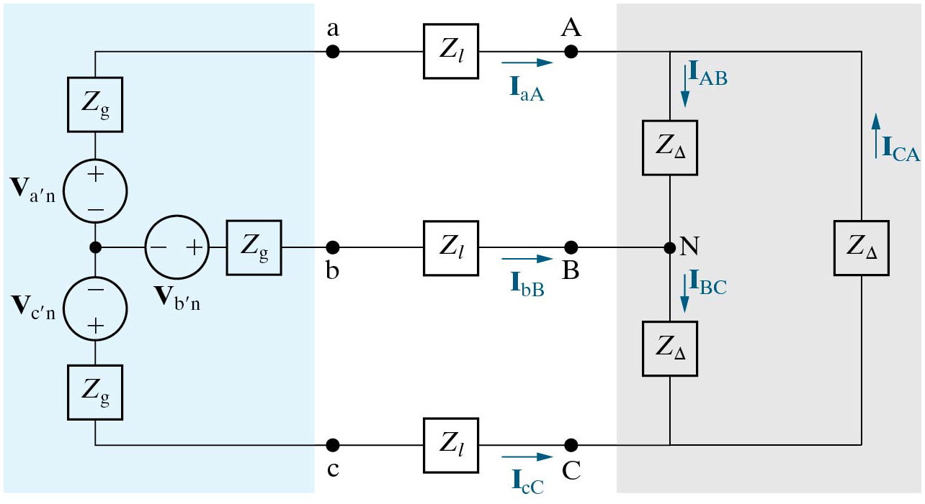
A Balanced Three Phase Y-Δ System
We will use this diagram to consider balanced Three-Phase circuits, with source in the Y-configuration and the load in the Δ-configuration.
The diagram is Figure 11.11 in the Nilsson and Reidel textbook, 12th Ed.

Slide 47
Terminology for Three Phase Y-Δ Systems
The diagram is Figure 11.11 in the Nilsson and Reidel textbook, 12th Ed.
Line voltage – voltage drop between two lines:
Phase voltage – voltage drop across a single phase:
Line current – current in a single line:
Phase current – current in a single phase:
In a
circuit, the line voltage and phase voltage are the same.
In a
circuit, the line current and phase current are different

Slide 48
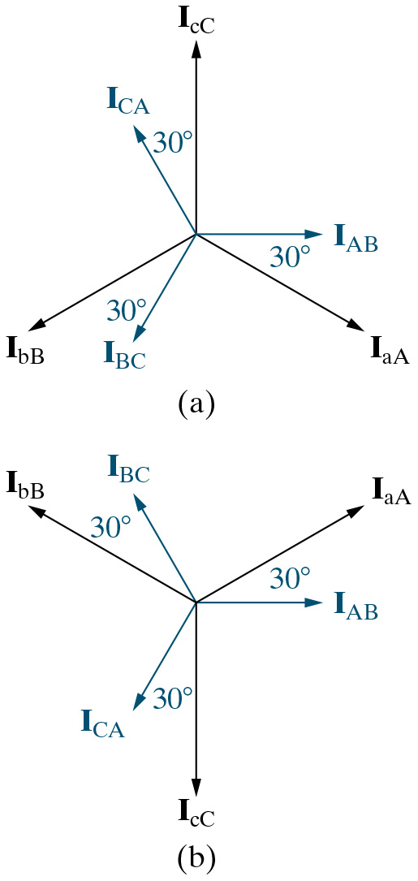
Line Currents and Phase Currents for Three Phase Y-Δ Systems
For the Y-Δ connection, we can use vector arithmetic to show that there is a relationship between the line currents and the phase currents.
The diagram is Figure 11.11 in the Nilsson and Reidel textbook, 12th Ed.
Positive (abc) sequence:
Negative (acb) sequence:

Slide 49
Review of Wye-to-Delta and Delta-to-Wye Transformations
We review here the equations for transforming from Y-configuration to the Δ-configuration and the reverse. You should have seen these in a previous course.

Slide 50
Wye-to-Delta and Delta-to-Wye Transformations for Balanced Loads
To match the textbook, we will convert to the phasor domain.

Slide 51
Wye-to-Delta and Delta-to-Wye Transformations for Balanced Loads
For balanced loads the three impedances will be equal for each configuration. This means that Z₁ = Z₂ = Z₃ = Z_{Y}, and Z_{A} = Z_{B} = Z_{C} = Z_{Δ} . We then have the following.
This result is given as Equation 11.9 in the Nilsson and Reidel textbook, 12th Ed.

Slide 52

Solving Three-Phase Y-Δ Systems
Analyze a balanced
circuit by replacing the
-connected load
with an equivalent Y-connected load, using:
Then analyze just the a-phase, just like before!
From the a-phase circuit, calculate
line current
voltage
Calculate line and phase voltage using
(abc or
acb). Remember that the line and phase voltages are the same in a delta- connected load.
Calculate phase current using
(acb or abc)
Calculate b-phase and c-phase voltages and currents by adding or
subtracting
from the phase angle of the a-phase values

Slide 53
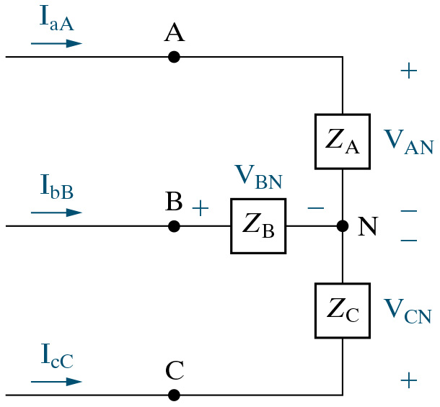
Power Calculations in Balanced Three-Phase Circuits
We are going to find the average power delivered to a single phase of a balanced wye-connected load. We begin by defining some variables we will use.
Let
The diagram is Figure 11.15 in the Nilsson and Reidel textbook, 12th Ed.

Slide 54
Power Calculations in Balanced Three-Phase Circuits
The average power in a single phase of the load is the product of the phase voltage magnitude, the phase current magnitude, and the cosine of the difference between the phase voltage angle and the phase current angle.
The diagram is Figure 11.15 in the Nilsson and Reidel textbook, 12th Ed.
Then, the total power delivered to the load is equal to the power absorbed by the three parts of the load,

Slide 55
Power Calculations in Balanced Three-Phase Circuits
We can also express the real power in terms of line voltages
and currents. Let the magnitude of the line voltage be
and
the magnitude of the line current be
Then,
This comes from the previous determination that the line voltage in a wye-connected load is equal to square-root of three times the phase voltage. Remember also that in these expressions, the voltage and current terms are the rms magnitudes of the voltage and current, respectively.

Slide 56
Power Calculations in Balanced Three-Phase Circuits
We can repeat this derivation for the delta-connected load.
and
Let the magnitude of the line voltage be
the magnitude of the line current be
Then,
This comes from the previous determination that the line current in a delta-connected load is equal to square-root of three times the phase current. The result is the same. Remember that the voltage and current terms are the rms magnitudes of the voltage and current, respectively.

Slide 57
Power Calculations in Balanced Three-Phase Circuits
These derivations also could have been done for complex power, and we would have
The derivations also could have been done for reactive power, and we would have

Slide 58
So what is the point of all this?
This is a good question. The choice has been made to have three phases in our sources, to trade off between complexity and even power delivery in sinusoidal power systems. Having made that choice, we have determined the formulas that relate the various quantities of interest, and generated jargon to talk about the quantities clearly. This is what we are learning about here.

